Slide 1
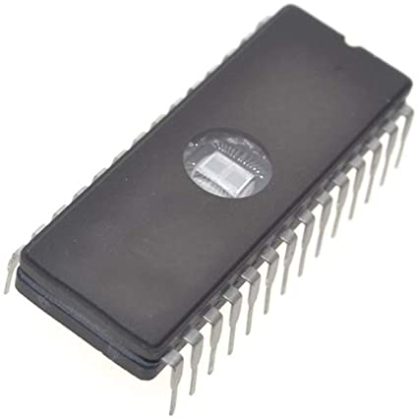
Partner Boot-Up Procedure
ROM
code
Loads & runs
Loader
Loads & runs
CP/M (OS)

Slide 2
Partner Versions
Partner (1983)
No graphics
Let’s call it “Early” Partner
Partner “G” (1987?)
WFG (Winchester [HDD] + Floppy + Graphics)
1FG (1 Floppy + Graphics) ← OUR MACHINE
2FG (2 Floppies + Graphics)

Slide 3
Resources Available
 | “Early” | 1FG (OURS) | WFG (EMU) | (2FG)
ROM |  |  | ✓
Floppy – Loader | ✓
Floppy – CP/M | ✓ |  | ✓
HDD – Loader |  |  | ✓
HDD – CP/M |  |  | ✓

Slide 4
Resources Available
 | “Early” | 1FG (OURS) | WFG (EMU) | (2FG)
ROM |  | ✓ | ✓
Floppy – Loader | ✓ | WE NEED
Floppy – CP/M | ✓ | WE NEED | ✓
HDD – Loader |  |  | ✓
HDD – CP/M |  |  | ✓

Slide 5
Attempt #1
 | “Early” | 1FG (OURS) | WFG (EMU) | (2FG)
ROM |  | ✓ | ✓
Floppy – Loader | ✓ | “Early”
Floppy – CP/M | ✓ | “Early” | ✓
HDD – Loader |  |  | ✓
HDD – CP/M |  |  | ✓

Slide 6
Attempt #1
Take the boot-up floppy for the “Early” Partner
Try to boot up our IDP 1FG
FAIL
Try to boot up the emulator
FAIL

Slide 7
Attempt #2 (Better)
 | “Early” | 1FG (OURS) | WFG (EMU) | (2FG)
ROM |  | ✓ | ✓
Floppy – Loader | ✓ | “Early”
Floppy – CP/M | ✓ | WFG | ✓
HDD – Loader |  |  | ✓
HDD – CP/M |  |  | ✓

Slide 8
Attempt #2
Create a boot-up floppy from the “Early” Loader and WFG’s “Floppy CP/M”
Try to boot up our IDP 1FG
FAIL
Try to boot up the emulator
SUCCESS (…WHAT?!)

Slide 9
Why Does It / Doesn’t It Work?
Can the ROM on our 1FG read a floppy disk … and run a program?
ROM
code
Loads & runs ← DOES THIS HAPPEN?
Loader
Loads & runs
CP/M (OS)

Slide 10
Why Does It / Doesn’t It Work?
We insert a short “beep” code at the beginning of the Loader
DB D9 | beep: in a, (0D9h) E6 04 | and 4 ; ready flag 28 FA | jr z, beep D3 D8 | out (0D8h), a ; A = 4 (long beep) 76 | halt
ROM
code
Loads & runs
Loader
Beep
Loads & runs
IT WORKS! ☺
CP/M (OS)

Slide 11
Why Does It / Doesn’t It Work?
What does the emulator trace tell us?
ROM Code Snippet ...
>>> 2FA JP #04D4
>>> 4D4 CALL #0484
Trace missing. This copies LOADER from diskette @ 0 to E000h.
>>> 4D7 LD A,(#E000)
>>> 4DA CP #C3 ; Then it checks LOADER signature which should be C3h
>>> 4DC JP Z,#04EA
>>> 4DF CP #31 ; ... or 31h
>>> 4E1 JP Z,#04EA
>>> 4EA JP #F600 ; ... Then it executes the code @ F600, which copies the code from E000h to 100h, and JP 100h
>>> F600 IN A,(#80)
*** IN 80 (izklop pomnilnika EPROM) = 80
>>> F602 LD HL,#E000
>>> F605 LD DE,#0100
>>> F608 LD BC,#1600
...
Loader Code Snippet ... >>> 4AD LD E,(HL)
>>> 4AE INC HL
>>> 4AF LD D,(HL)
>>> 4B0 INC HL
>>> 4B1 LD B,(HL)
>>> 4B2 RET
>>> 4B6 CALL #0B27 <- This checkpoint is reached
*** BIOS 13 (READ), A = 0, BC = CE
*** Offset: 2400
>>> 4B9 OR A <- This checkpoint is NOT reached
>>> 4BA RET Z
>>> 69B LD HL,(#09DC)
>>> 69E JP #06A7
>>> 6A7 LD (#098A),HL ...

Slide 12
Now What?
ROM can read a floppy disk
Loader cannot read a floppy disk
We need to look into the ROM code to see how it differs from the Loader code
We need to dump the ROM
Take it out, read it with an EPROM reader (we didn’t have it, we didn’t want to mess with the hardware at this point)
Through communication ports (we didn’t know how to make them work)
Dump onto the screen, OCR, disassemble ← THIS IS WHAT WE DID

Slide 13
Dumping the ROM
We insert the “ROM dump” code at the beginning of the Loader
ROM
code
Loads & runs
Loader
ROM Dumper
Loads & runs
CP/M (OS)

Slide 14
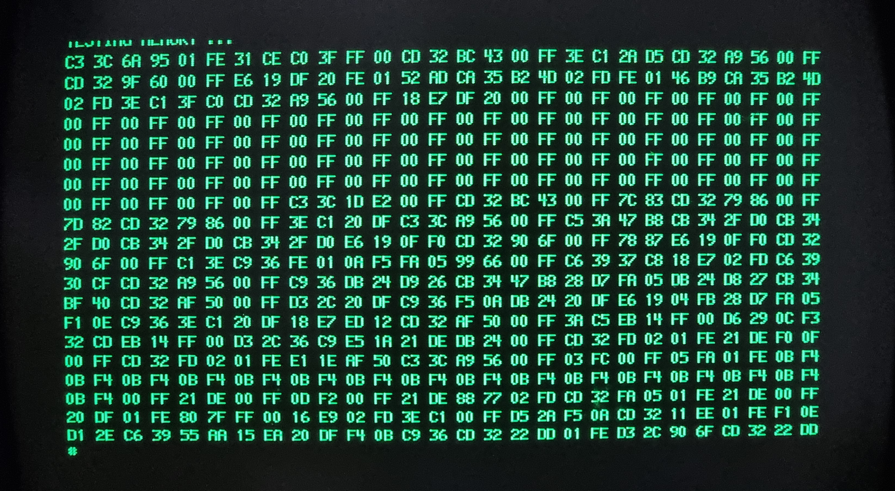
Dumping the ROM
“C3” First byte
“3C” First byte’s complement

Slide 15
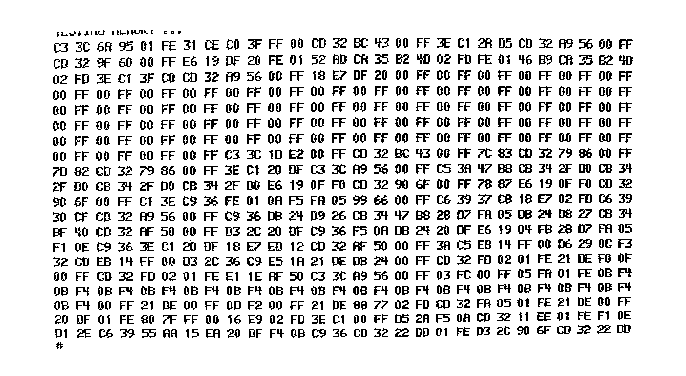
Dumping the ROM
2. Take photo (Thx, Matjaž ☺)
3. Apply filter

Slide 16
Dumping the ROM
C3 3C 6A 95 01 FE 31 CE CO 3F FF 00 CD 32 BC 43 00 FF 3E C1 2R 05 CD 32 R9 56 00 FF
CD 32 9F 60 00 FF E6 19 OF 20 FE 01 52 AD CA 35 B2 40 02 FD FE 01 lf6 89 CA 35 82 lffl
02 FD 3E C1 3F CO CD 32 A9 56 00 FF 18 E7 DF 20 00 FF 00 FF 00 FF 00 FF 00 FF 00 FF
00 FF 00 FF 00 FF 00 FF 00 FF 00 FF 00 FF 00 FF 00 FF 00 FF 00 FF 00 FF 00 FF 00 FF
00 FF 00 FF 00 FF 00 FF 00 FF 00 FF 00 FF 00 FF 00 FF 00 FF 00 FF 00 FF 00 FF 00 FF
00 FF 00 FF 00 FF 00 FF 00 FF 00 FF 00 FF 00 FF 00 FF 00 FF 00 FF 00 FF 00 FF 00 FF
00 FF 00 FF 00 FF 00 FF 00 FF 00 FF 00 FF 00 FF 00 FF 00 FF 00 FF 00 FF 00 FF 00 FF
00 FF 00 FF 00 FF 00 FF C3 3C 1D E2 00 FF CD 32 BC 43 00 FF 7C 83 CD 32 79 86 00 FF
7D 82 CO 32 79 86 00 FF 3E C1 20 DF C3 3C A9 56 00 FF C5 3A 't7 B8 CB 3't 2F DO CB 3'J
2F 00 CB 3'f 2F 00 CB 3'f 2F DO E6 19 OF FO CO 32 90 6F 00 FF 78 87 E6 19 OF FO CD 32
90 6F 00 FF C1 3E C9 36 FE 01 OA F5 FA 05 99 66 00 FF C6 39 37 C8 18 E7 02 FD C6 39
30 CF CD 32 A9 56 00 FF C9 36 DB 2't 09 26 CB 3'f 'f7 88 28 07 FA 05 DB 2't 08 27 CB 31f
BF 'tO CD 32 AF 50 00 FF D3 2C 20 OF C9 36 F5 OA DB 2't 20 DF E6 19 O'f FB 28 07 FA 05
F1 OE C9 36 3E C1 20 DF 18 E7 ED 12 CD 32 AF 50 00 FF 3A CS EB 1't FF 00 06 29 OC F3
32 CO EB 1'f FF 00 03 2C 36 C9 ES 1A 21 OE DB 24 00 FF CD 32 FD 02 01 FE 21 DE FO OF
00 FF CD 32 FD 02 01 FE E1 1E AF 50 C3 3C A9 56 00 FF 03 FC 00 FF 05 FA 01 FE OB PJ
OB F'f OB F'f 08 F'f OB F'f OB F4 OB F'f OB F'f OB F4 OB F4 OB F4 OB Pt OB Pt OB F't OB Pl
OB F4 00 FF 21 OE 00 FF 00 F2 00 FF 21 DE 88 77 02 FD CD 32 FA 05 01 FE 21 DE 00 FF
20 OF 01 FE 80 7F FF 00 16 E9 02 FD 3E C1 00 FF 05 2A F5 OA CD 32 11 EE 01 FE F1 OE
01 2E C6 39 55 AA 15 EA 20 OF F4 OB C9 36 CD 32 22 DD 01 FE D3 2C 90 6F CD 32 22 OD
#
C3 3C 6A 95 01 FE 31 CE C0 3F FF 00 CD 32 BC 43 00 FF 3E C1 2A D5 CD 32 A9 56 00 FF
CD 32 9F 60 00 FF E6 19 DF 20 FE 01 52 AD CA 35 B2 4D 02 FD FE 01 46 B9 CA 35 B2 4D
02 FD 3E C1 3F C0 CD 32 A9 56 00 FF 18 E7 DF 20 00 FF 00 FF 00 FF 00 FF 00 FF 00 FF
00 FF 00 FF 00 FF 00 FF 00 FF 00 FF 00 FF 00 FF 00 FF 00 FF 00 FF 00 FF 00 FF 00 FF
00 FF 00 FF 00 FF 00 FF 00 FF 00 FF 00 FF 00 FF 00 FF 00 FF 00 FF 00 FF 00 FF 00 FF
00 FF 00 FF 00 FF 00 FF 00 FF 00 FF 00 FF 00 FF 00 FF 00 FF 00 FF 00 FF 00 FF 00 FF
00 FF 00 FF 00 FF 00 FF 00 FF 00 FF 00 FF 00 FF 00 FF 00 FF 00 FF 00 FF 00 FF 00 FF
00 FF 00 FF 00 FF 00 FF C3 3C 1D E2 00 FF CD 32 BC 43 00 FF 7C 83 CD 32 79 86 00 FF
7D 82 CD 32 79 86 00 FF 3E C1 20 DF C3 3C A9 56 00 FF C5 3A 47 B8 CB 34 2F D0 CB 34
2F D0 CB 34 2F D0 CB 34 2F D0 E6 19 0F F0 CD 32 90 6F 00 FF 78 87 E6 19 0F F0 CD 32
90 6F 00 FF C1 3E C9 36 FE 01 0A F5 FA 05 99 66 00 FF C6 39 37 C8 18 E7 02 FD C6 39
30 CF CD 32 A9 56 00 FF C9 36 DB 24 D9 26 CB 34 47 B8 28 D7 FA 05 DB 24 D8 27 CB 34
BF 40 CD 32 AF 50 00 FF D3 2C 20 DF C9 36 F5 0A DB 24 20 DF E6 19 04 FB 28 D7 FA 05
F1 0E C9 36 3E C1 20 DF 18 E7 ED 12 CD 32 AF 50 00 FF 3A C5 EB 14 FF 00 D6 29 0C F3
32 CD EB 14 FF 00 D3 2C 36 C9 E5 1A 21 DE DB 24 00 FF CD 32 FD 02 01 FE 21 DE F0 0F
00 FF CD 32 FD 02 01 FE E1 1E AF 50 C3 3C A9 56 00 FF 03 FC 00 FF 05 FA 01 FE 0B F4
0B F4 0B F4 0B F4 0B F4 0B F4 0B F4 0B F4 0B F4 0B F4 0B F4 0B F4 0B F4 0B F4 0B F4
0B F4 00 FF 21 DE 00 FF 0D F2 00 FF 21 DE 88 77 02 FD CD 32 FA 05 01 FE 21 DE 00 FF
20 DF 01 FE 80 7F FF 00 16 E9 02 FD 3E C1 00 FF D5 2A F5 0A CD 32 11 EE 01 FE F1 0E
D1 2E C6 39 55 AA 15 EA 20 DF F4 0B C9 36 CD 32 22 DD 01 FE D3 2C 90 6F CD 32 22 DD
#
4. OCR (Adobe Acrobat)
5. Apply corrections (e.g., 'J→4, 't→4)

Slide 17
Dumping the ROM
...
; Nerabljene procedure za izpis sxestnajstisxkih sxtevil.
0082 0069 CD BC 00 CALL PrelomVrstice
0083 006C 7C LD A,H
0084 006D CD 79 00 CALL IzpisiHex8
0085 0070 7D LD A,L
0086 0071 CD 79 00 CALL IzpisiHex8
0087 0074 3E 20 LD A,20H
0088 0076 C3 A9 00 JP GDPUkaz
0089 0079 C5 IzpisiHex8: PUSH BC
0090 007A 47 LD B,A
0091 007B CB 2F SRA A
0092 007D CB 2F SRA A
0093 007F CB 2F SRA A
0094 0081 CB 2F SRA A
0095 0083 E6 0F AND 0FH
0096 0085 CD 90 00 CALL IzpisiHex4
0097 0088 78 LD A,B
0098 0089 E6 0F AND 0FH
0099 008B CD 90 00 CALL IzpisiHex4
0100 008E C1 POP BC
0101 008F C9 RET
0102 0090 FE 0A IzpisiHex4: CP 0AH
0103 0092 FA 99 00 JP M,L0010
0104 0095 C6 37 ADD A,37H
0105 0097 18 02 JR L0011
0106 0099 C6 30 L0010: ADD A,30H
0107 009B CD A9 00 L0011: CALL GDPUkaz
0108 009E C9 RET
; Pocxaka, da uporabnik pritisne tipko na tipkovnici,
; nato izpisxe njen znak na GDP.
0109 009F DB D9 BeriInIzpisiZnak: IN A,(0D9H)
0110 00A1 CB 47 BIT 0,A
0111 00A3 28 FA JR Z,BeriInIzpisiZnak
0112 00A5 DB D8 IN A,(0D8H)
0113 00A7 CB BF RES 7,A
; Posxlje ukaz na GDP.
0114 00A9 CD AF 00 GDPUkaz: CALL CakajGDP
0115 00AC D3 20 OUT (20H),A
0116 00AE C9 RET
...
C3 3C 6A 95 01 FE 31 CE C0 3F FF 00 CD 32 BC 43 00 FF 3E C1 2A D5 CD 32 A9 56 00 FF
CD 32 9F 60 00 FF E6 19 DF 20 FE 01 52 AD CA 35 B2 4D 02 FD FE 01 46 B9 CA 35 B2 4D
02 FD 3E C1 3F C0 CD 32 A9 56 00 FF 18 E7 DF 20 00 FF 00 FF 00 FF 00 FF 00 FF 00 FF
00 FF 00 FF 00 FF 00 FF 00 FF 00 FF 00 FF 00 FF 00 FF 00 FF 00 FF 00 FF 00 FF 00 FF
00 FF 00 FF 00 FF 00 FF 00 FF 00 FF 00 FF 00 FF 00 FF 00 FF 00 FF 00 FF 00 FF 00 FF
00 FF 00 FF 00 FF 00 FF 00 FF 00 FF 00 FF 00 FF 00 FF 00 FF 00 FF 00 FF 00 FF 00 FF
00 FF 00 FF 00 FF 00 FF 00 FF 00 FF 00 FF 00 FF 00 FF 00 FF 00 FF 00 FF 00 FF 00 FF
00 FF 00 FF 00 FF 00 FF C3 3C 1D E2 00 FF CD 32 BC 43 00 FF 7C 83 CD 32 79 86 00 FF
7D 82 CD 32 79 86 00 FF 3E C1 20 DF C3 3C A9 56 00 FF C5 3A 47 B8 CB 34 2F D0 CB 34
2F D0 CB 34 2F D0 CB 34 2F D0 E6 19 0F F0 CD 32 90 6F 00 FF 78 87 E6 19 0F F0 CD 32
90 6F 00 FF C1 3E C9 36 FE 01 0A F5 FA 05 99 66 00 FF C6 39 37 C8 18 E7 02 FD C6 39
30 CF CD 32 A9 56 00 FF C9 36 DB 24 D9 26 CB 34 47 B8 28 D7 FA 05 DB 24 D8 27 CB 34
BF 40 CD 32 AF 50 00 FF D3 2C 20 DF C9 36 F5 0A DB 24 20 DF E6 19 04 FB 28 D7 FA 05
F1 0E C9 36 3E C1 20 DF 18 E7 ED 12 CD 32 AF 50 00 FF 3A C5 EB 14 FF 00 D6 29 0C F3
32 CD EB 14 FF 00 D3 2C 36 C9 E5 1A 21 DE DB 24 00 FF CD 32 FD 02 01 FE 21 DE F0 0F
00 FF CD 32 FD 02 01 FE E1 1E AF 50 C3 3C A9 56 00 FF 03 FC 00 FF 05 FA 01 FE 0B F4
0B F4 0B F4 0B F4 0B F4 0B F4 0B F4 0B F4 0B F4 0B F4 0B F4 0B F4 0B F4 0B F4 0B F4
0B F4 00 FF 21 DE 00 FF 0D F2 00 FF 21 DE 88 77 02 FD CD 32 FA 05 01 FE 21 DE 00 FF
20 DF 01 FE 80 7F FF 00 16 E9 02 FD 3E C1 00 FF D5 2A F5 0A CD 32 11 EE 01 FE F1 0E
D1 2E C6 39 55 AA 15 EA 20 DF F4 0B C9 36 CD 32 22 DD 01 FE D3 2C 90 6F CD 32 22 DD
#
6. Disassemble

Slide 18
Diff ROM vs Loader
... 0537 03A5 CD B9 04 __MAIN__: CALL L0063
0672 04B9 CD A5 04 L0063: CALL __CHECK_BIT_AT_98__
0673 04BC C2 C4 04 JP NZ,L0080
0674 04BF D3 98 OUT (98H),A
0675 04C1 CD AA 04 CALL __DELAY__
0676 04C4 AF L0080: XOR A
0677 04C5 D3 98 OUT (98H),A
0678 04C7 3E 47 LD A,47H
0679 04C9 D3 C8 OUT (0C8H),A
0680 04CB D3 C9 OUT (0C9H),A
0681 04CD 3E 82 LD A,82H
0682 04CF D3 C8 OUT (0C8H),A
0683 04D1 D3 C9 OUT (0C9H),A
0684 04D3 3E A7 LD A,0A7H
0685 04D5 D3 CA OUT (0CAH),A
0686 04D7 3E FF LD A,0FFH
0687 04D9 D3 CA OUT (0CAH),A
0688 04DB C9 RET
0538 03A8 3E 0F LD A,0FH
0539 03AA CD EF 02 CALL __IN_F0_OUT_F1__
0540 03AD CD D3 03 CALL __SOME_COMP__
0541 03B0 CD EF 02 L0066: CALL __IN_F0_OUT_F1__
0542 03B3 3A D1 FF LD A,(0FFD1H)
0543 03B6 CD EF 02 CALL __IN_F0_OUT_F1__
0544 03B9 FB EI
0545 03BA 76 HALT
0546 03BB 3E 08 L0067: LD A,08H
0547 03BD CD EF 02 CALL __IN_F0_OUT_F1__
0548 03C0 CD FD 02 CALL __IN_F0_IN_F1__
0549 03C3 CD FD 02 CALL __IN_F0_IN_F1__
0550 03C6 47 LD B,A
0551 03C7 3A D1 FF LD A,(0FFD1H)
0552 03CA B8 CP B
0553 03CB CA D1 03 JP Z,L0065
0554 03CE AF XOR A
0555 03CF 3C INC A
0556 03D0 C9 RET
0557 03D1 AF L0065: XOR A
0558 03D2 C9 RET
0481 032C C0 RET NZ
...
0492 0344 F6 40 OR 40H
0493 0346 CD E2 03 CALL L0056
0569 03E2 CD EF 02 L0056: CALL __IN_F0_OUT_F1__
0570 03E5 CD D3 03 CALL __SOME_COMP__
0571 03E8 CD EF 02 CALL __IN_F0_OUT_F1__
0572 03EB 3A D1 FF LD A,(0FFD1H)
0573 03EE CD EF 02 CALL __IN_F0_OUT_F1__
0574 03F1 3A D7 FF LD A,(0FFD7H)
0575 03F4 CD EF 02 CALL __IN_F0_OUT_F1__
0576 03F7 3A D4 FF LD A,(0FFD4H)
0577 03FA CD EF 02 CALL __IN_F0_OUT_F1__
0578 03FD C9 RET
0494 0349 CD FE 03 CALL L0057
0579 03FE 3E 01 L0057: LD A,01H
0580 0400 CD EF 02 CALL __IN_F0_OUT_F1__
0581 0403 3A D4 FF LD A,(0FFD4H)
0582 0406 CD EF 02 CALL __IN_F0_OUT_F1__
0583 0409 3E 0A LD A,0AH
0584 040B CD EF 02 CALL __IN_F0_OUT_F1__
0585 040E 3E FF LD A,0FFH
0586 0410 CD EF 02 CALL __IN_F0_OUT_F1__
0587 0413 C9 RET
0495 034C FB L0059: EI 0496 034D 76 HALT
0497 034E DA 63 03 JP C,L0058 ...
... 3093 108F 32 21 0C LD (0C21H),A
3094 1092 CD 31 11 CALL __OUT_98_OUT_CX__
3095 1095 3E 0F LD A,0FH
3096 1097 CD FF 0F CALL __IN_F0_OUT_F1__
3097 109A CD C0 10 CALL __SOME_COMP__
3098 109D CD FF 0F CALL __IN_F0_OUT_F1__
3099 10A0 3A 21 0C LD A,(0C21H)
3100 10A3 CD FF 0F CALL __IN_F0_OUT_F1__
3101 10A6 FB EI
3102 10A7 76 HALT
3103 10A8 3E 08 LD A,08H
3104 10AA CD FF 0F CALL __IN_F0_OUT_F1__
3105 10AD CD 0D 10 CALL __IN_F0_IN_F1__
3106 10B0 CD 0D 10 CALL __IN_F0_IN_F1__
3107 10B3 47 LD B,A
3108 10B4 3A 21 0C LD A,(0C21H)
3109 10B7 B8 CP B
3110 10B8 CA BE 10 JP Z,L0197
3111 10BB AF XOR A
3112 10BC 3C INC A
3113 10BD C9 RET
3060 1045 C0 RET NZ
3061 1046 3E 46 LD A,46H
3062 1048 CD CA 10 CALL L0190
3122 10CA CD FF 0F L0190: CALL __IN_F0_OUT_F1__
3123 10CD CD C0 10 CALL __SOME_COMP__
3124 10D0 CD FF 0F CALL __IN_F0_OUT_F1__
3125 10D3 3A 21 0C LD A,(0C21H)
3126 10D6 CD FF 0F CALL __IN_F0_OUT_F1__
3127 10D9 3A 23 0C LD A,(0C23H)
3128 10DC CD FF 0F CALL __IN_F0_OUT_F1__
3129 10DF 3A 1E 0C LD A,(0C1EH)
3130 10E2 CD FF 0F CALL __IN_F0_OUT_F1__
3131 10E5 C9 RET
3063 104B CD E6 10 CALL L0191
3132 10E6 3E 01 L0191: LD A,01H
3133 10E8 CD FF 0F CALL __IN_F0_OUT_F1__
3134 10EB 3A 1E 0C LD A,(0C1EH)
3135 10EE CD FF 0F CALL __IN_F0_OUT_F1__
3136 10F1 3E 0A LD A,0AH
3137 10F3 CD FF 0F CALL __IN_F0_OUT_F1__
3138 10F6 3E FF LD A,0FFH
3139 10F8 CD FF 0F CALL __IN_F0_OUT_F1__
3140 10FB C9 RET
3064 104E FB EI
3065 104F 76 HALT
3066 1050 CD 0D 10 CALL __IN_F0_IN_F1__
...
3177 1131 CD 1F 11 __OUT_98_OUT_CX__: CALL __IN_98__
3178 1134 C2 3A 11 JP NZ,L0204
3179 1137 CD 24 11 CALL __DELAY__
3180 113A AF L0204: XOR A
3181 113B D3 98 OUT (98H),A
3182 113D 3E 47 LD A,47H
3183 113F D3 C8 OUT (0C8H),A
3184 1141 D3 C9 OUT (0C9H),A
3185 1143 3E 82 LD A,82H
3186 1145 D3 C8 OUT (0C8H),A
3187 1147 D3 C9 OUT (0C9H),A
3188 1149 C9 RET
...
Same, same, but different
ROM
Loader

Slide 19
Diff ROM vs Loader
5 notable differences are identifed, it turns out we only need to take 2 into account
ROM has a different “__SOME_COMP__” function
ROM registers the FDC/CTC interrupt handlers differently
__SOME_COMP__ @ ROM LD A,(0FFD7H) ; get it from C23h (set if track number is odd) RLCA RLCA AND 04H PUSH BC ; this code doesn’t really do anything LD B,A LD A,(0FFD0H) ; always 0 OR B POP BC RET | __SOME_COMP__ @ “Vzorcna” LD A,(0C23H) RLCA RLCA AND 04H OR 01H RET
IVT init @ ROM LD HL,02E8H LD A,L OUT (0E8H),A OUT (0C8H),A LD A,H LD I,A EI | IVT init @ “Vzorcna” LD HL,0B64H LD A,L OUT (0E8H),A LD A,H LD I,A EI

Slide 20
Finally! … Yes, this is all there is to it.
; Base image is ‘Vzorcna' with CPM3.GSR instead of the original CPM3.SYS (but still called CPM3.SYS)
; Base image requires the following changes:
; * BIOS13 JUMP: 1920 | 0B27 C3 E3 0B | L0053: JP L0163
; A27H CHANGE TO C3 9A 0A
; * CALL TO __SOME_COMP__ #1: 3097 | 109A CD C0 10 | CALL L0196
; F9AH CHANGE TO CD 92 0A
; * CALL TO __SOME_COMP__ #2: 3123 | 10CD CD C0 10 | CALL L0196
; FCDH CHANGE TO CD 92 0A
; * The following code needs to be inserted at 990H:
LoaderBIOS13 EQU BE3H
ORG A90H
; IVT needs to be at an address where the low 3 bits are 0 (see http://www.z80.info/zip/z80ctc.pdf)
IVT:
DW 10FCH
; ---------------------------------------------------------
__SOME_COMP__:
LD A,(0C23H)
RLCA
RLCA
AND 04H
RET
; ---------------------------------------------------------
BIOS13:
LD HL,IVT
LD A,L
OUT (0E8H),A
OUT (0C8H),A
LD A,H
LD I,A
EI
JP LoaderBIOS13
Take the “Early” boot-up disk image and replace CPM3.SYS with CPM3.GSR from WFG
Replace the jump to BIOS 13 with a jump to the new function
Replace the calls to __SOME_COMP__ with calls to the new function
Insert the new code

Slide 21
